Slide 1
Numerical integration: midpoint in serial and parallel
Students of The Parallel Computing
Viktor Seredovych
Sri Ram Prasath Ramasubramaniyan
Sofiia Prokofieva
Emmanuil Prokopov
Pliiev Alan
L’Aquila – 2022

Slide 2
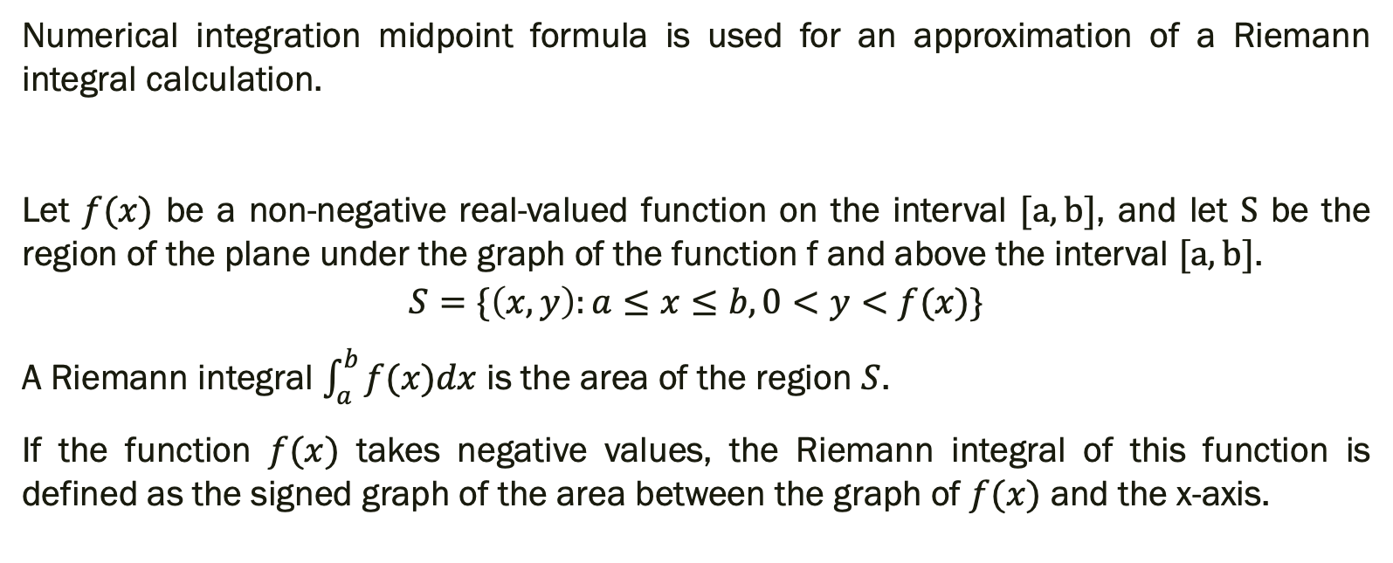
Math problem
Numerical integration midpoint formula is used for an approximation of a Riemann integral calculation.
Let $f(x)$ be a non-negative real-valued function on the interval $[a, b]$, and let $S$ be the region of the plane under the graph of the function f and above the interval $[a, b]$.
$$S=\{\left(x,y\right):a≤x≤b, 0<y<f(x)\}$$
A Riemann integral $\int_{a}^{b}{f(x)dx}$ is the area of the region $S$.
If the function $f(x)$ takes negative values, the Riemann integral of this function is defined as the signed graph of the area between the graph of $f(x)$ and the x-axis.

Slide 3
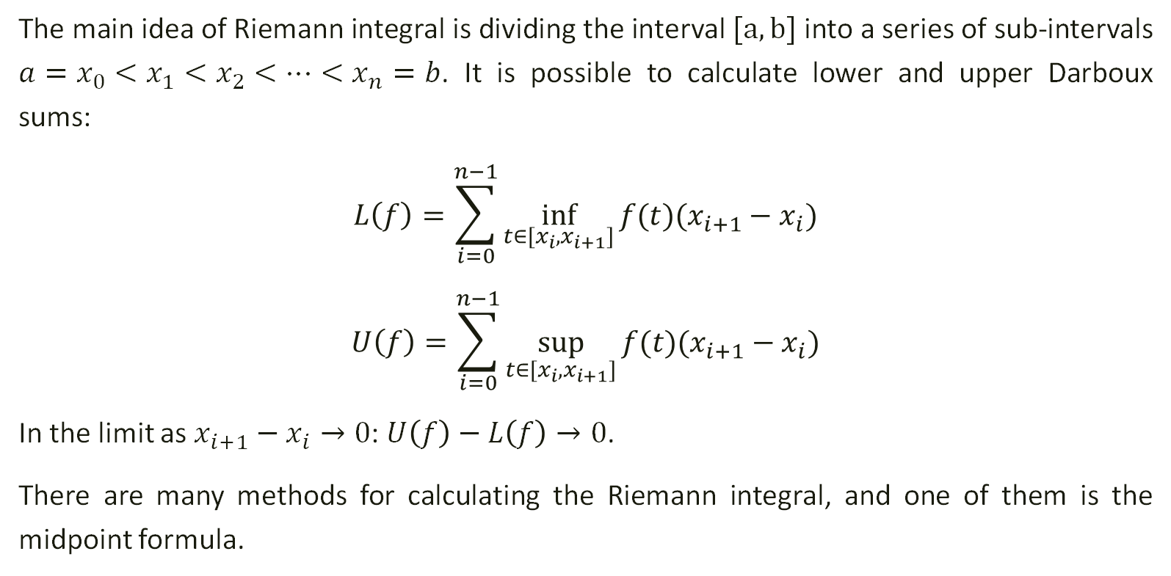
Numerical method
The main idea of Riemann integral is dividing the interval $[a, b]$ into a series of sub-intervals $a=x_{0}<x_{1}<x_{2}<…<x_{n}=b$. It is possible to calculate lower and upper Darboux sums:
$$L\left(f\right)=\sum_{i=0}^{n−1}{\inf_{t∈[x_{i}, x_{i+1}]}{f(t)(x_{i+1}−x_{i})}}$$
$$U\left(f\right)=\sum_{i=0}^{n−1}{\sup_{t∈[x_{i}, x_{i+1}]}{f(t)(x_{i+1}−x_{i})}}$$
In the limit as $x_{i+1}−x_{i}→0$: $U\left(f\right)−L\left(f\right)→0$.
There are many methods for calculating the Riemann integral, and one of them is the midpoint formula.

Slide 4
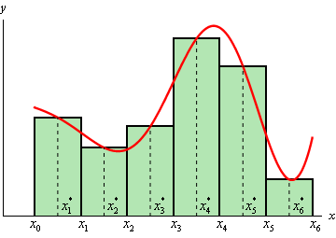
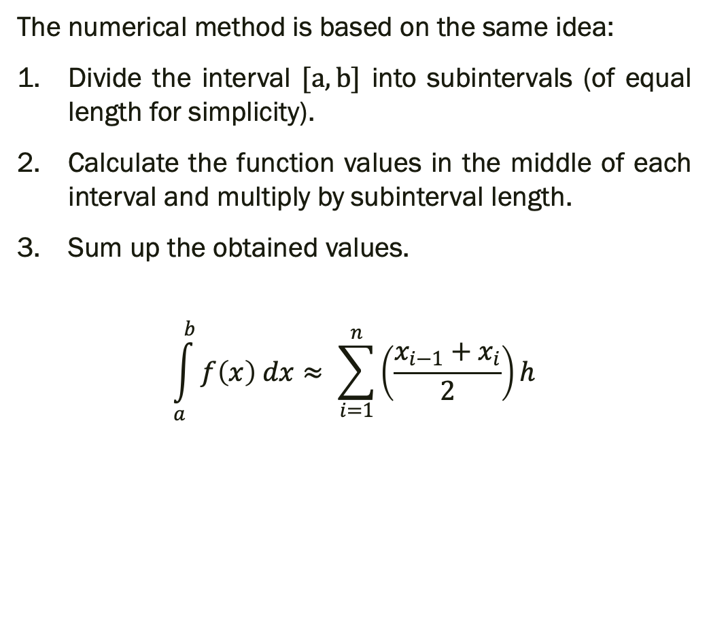
Midpoint Formula
The numerical method is based on the same idea:
Divide the interval $[a, b]$ into subintervals (of equal length for simplicity).
Calculate the function values in the middle of each interval and multiply by subinterval length.
Sum up the obtained values.
$$\int_{a}^{b}{f\left(x\right) dx≈ \sum_{i=1}^{n}{\left(\frac{x_{i−1}{+ x}_{i}}{2}\right)h}}$$

Slide 5
Parallel algorithm
The midpoint integration algorithm could be optimized with parallelization by distributing calculation on each subinterval between all available processes. It can be accomplished with the following steps.
Each process takes the interval according to its ID.
The next interval is chosen by shifting from the current interval on the number of processes.
Each process calculates the partial sums which represent the integral on their subintervals.
All partial sums are added together to get the final approximated integral.

Slide 6
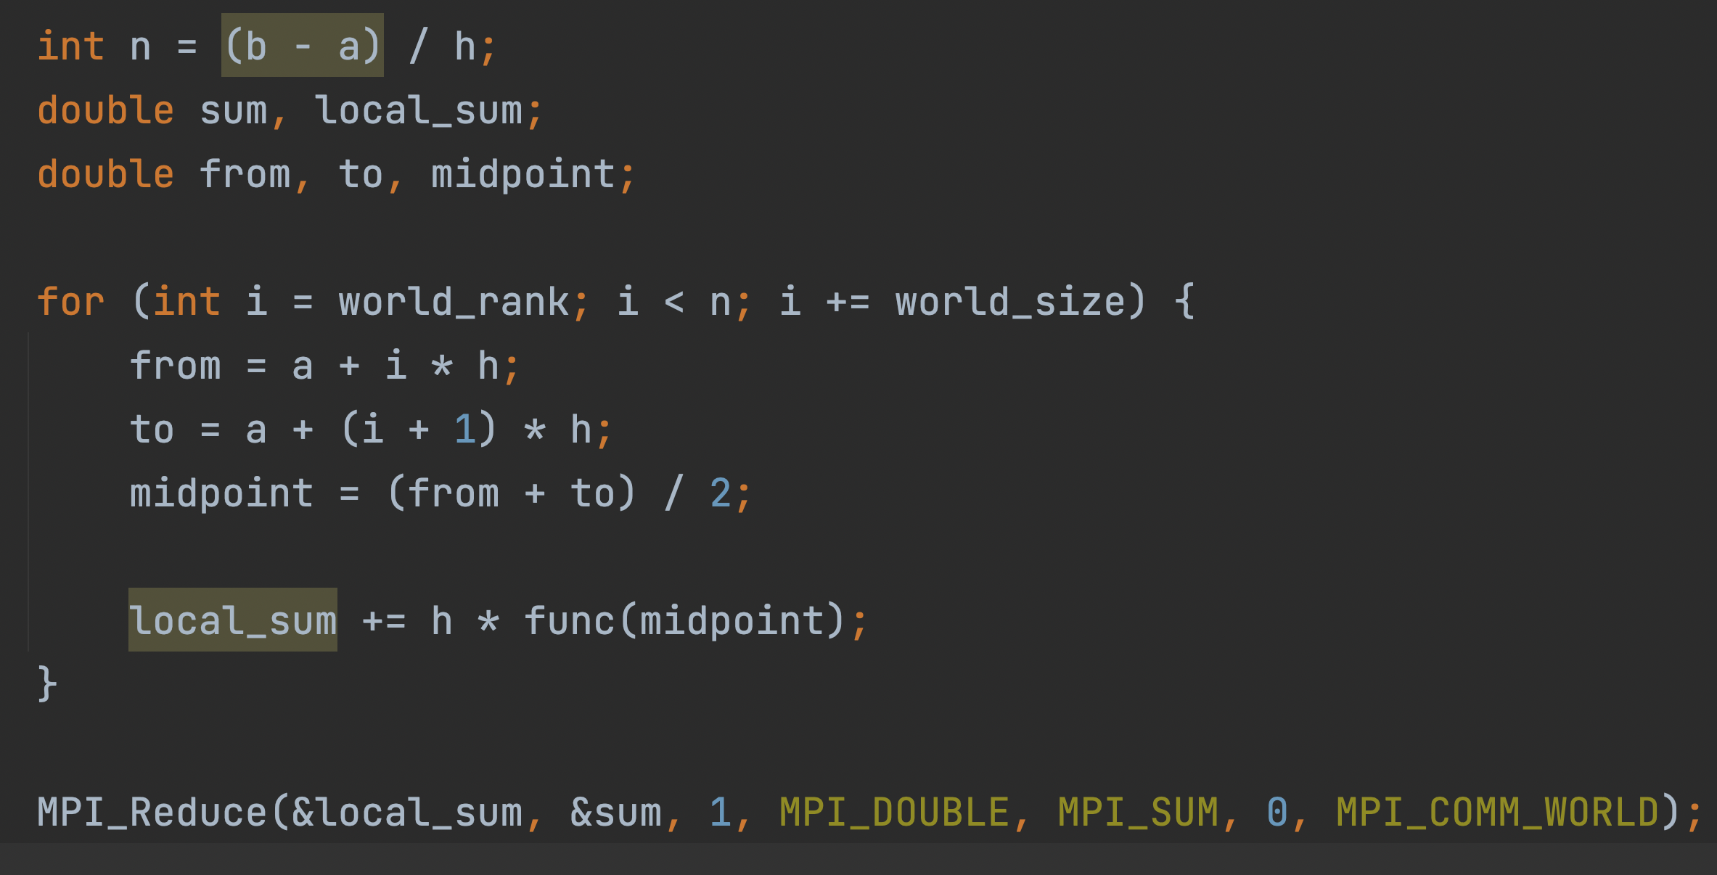
MPI Code

Slide 7
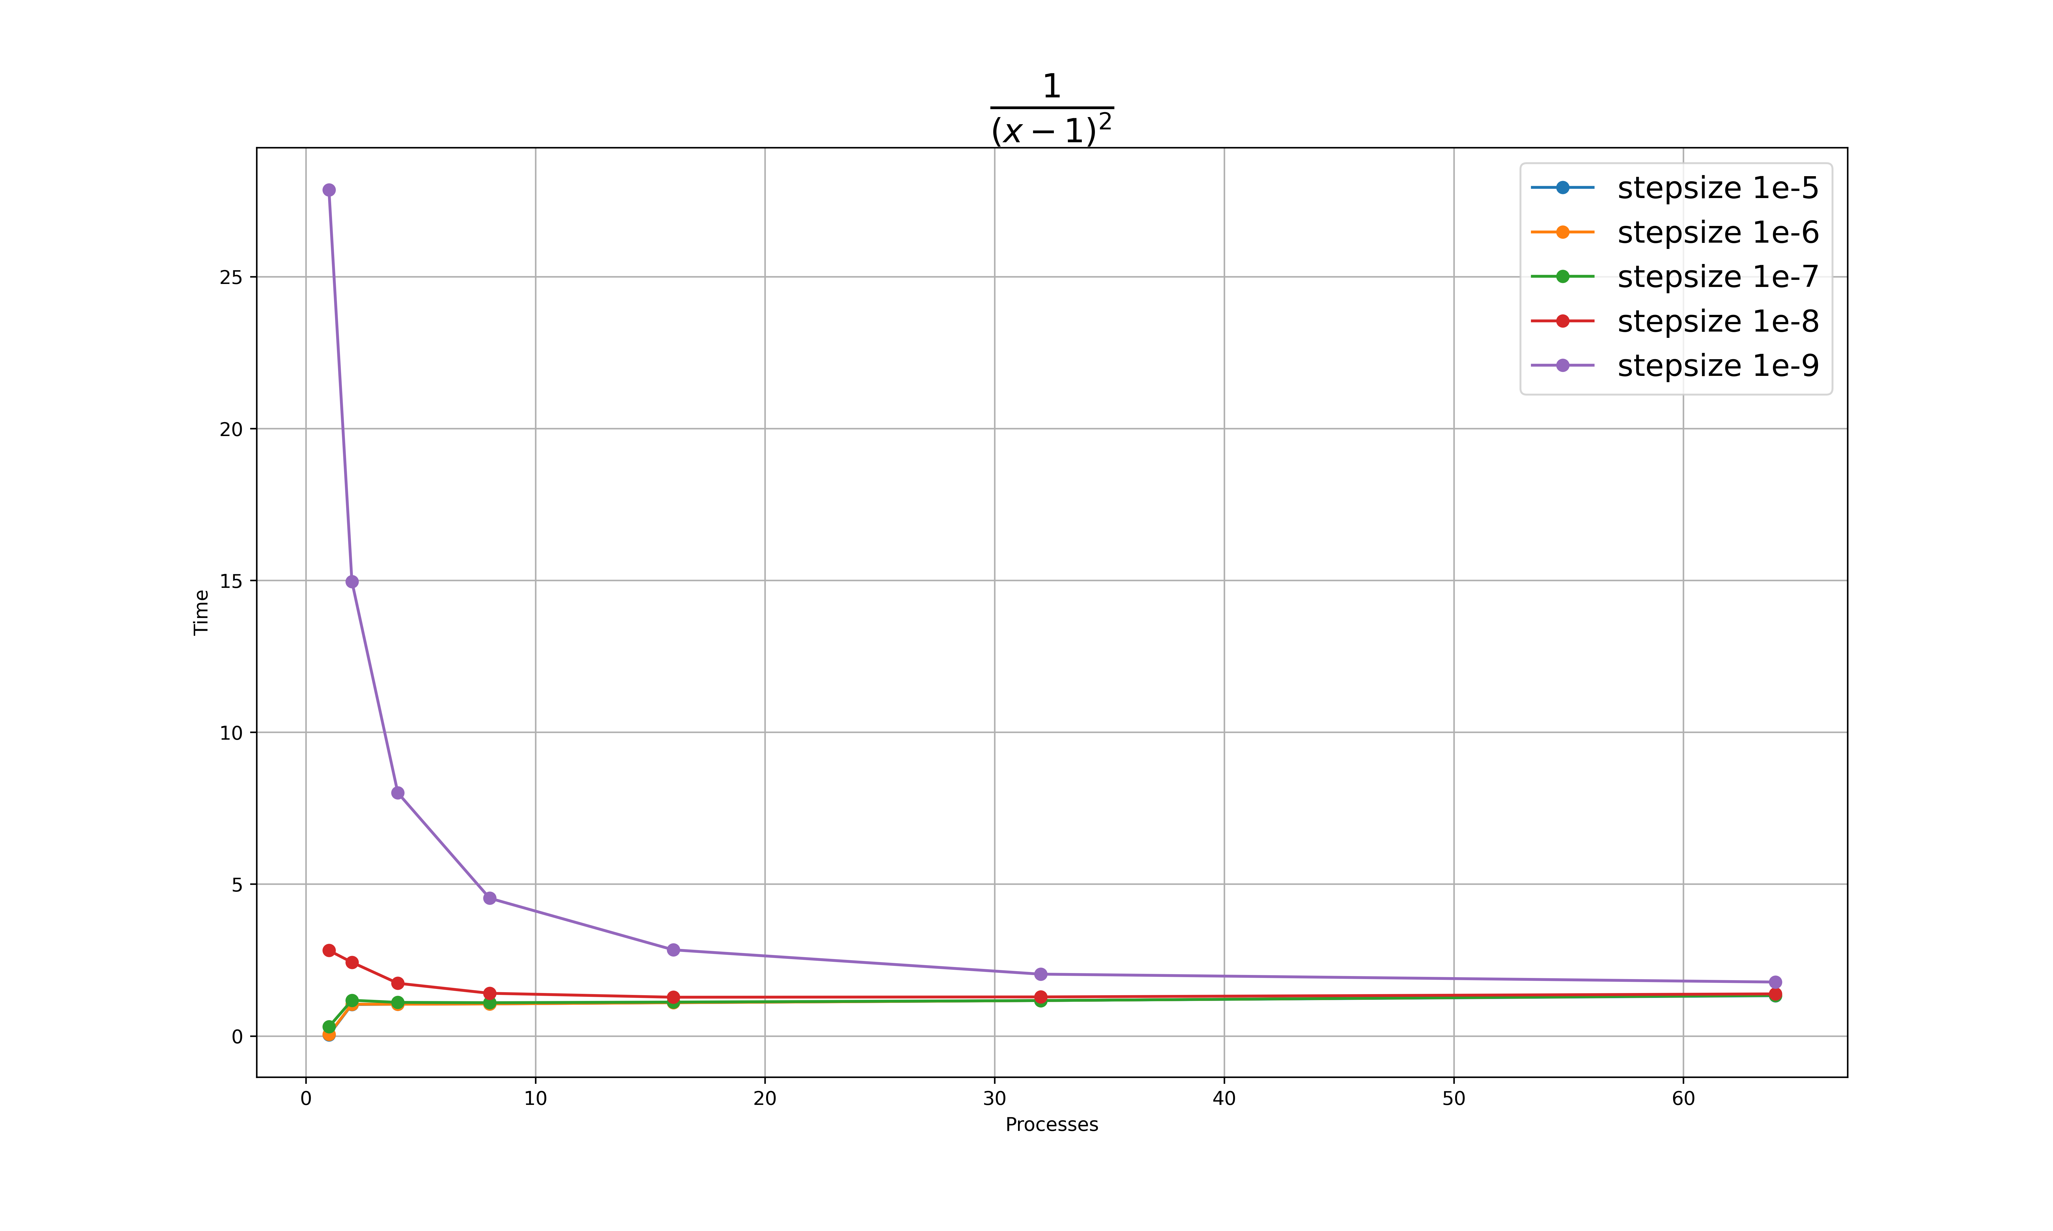
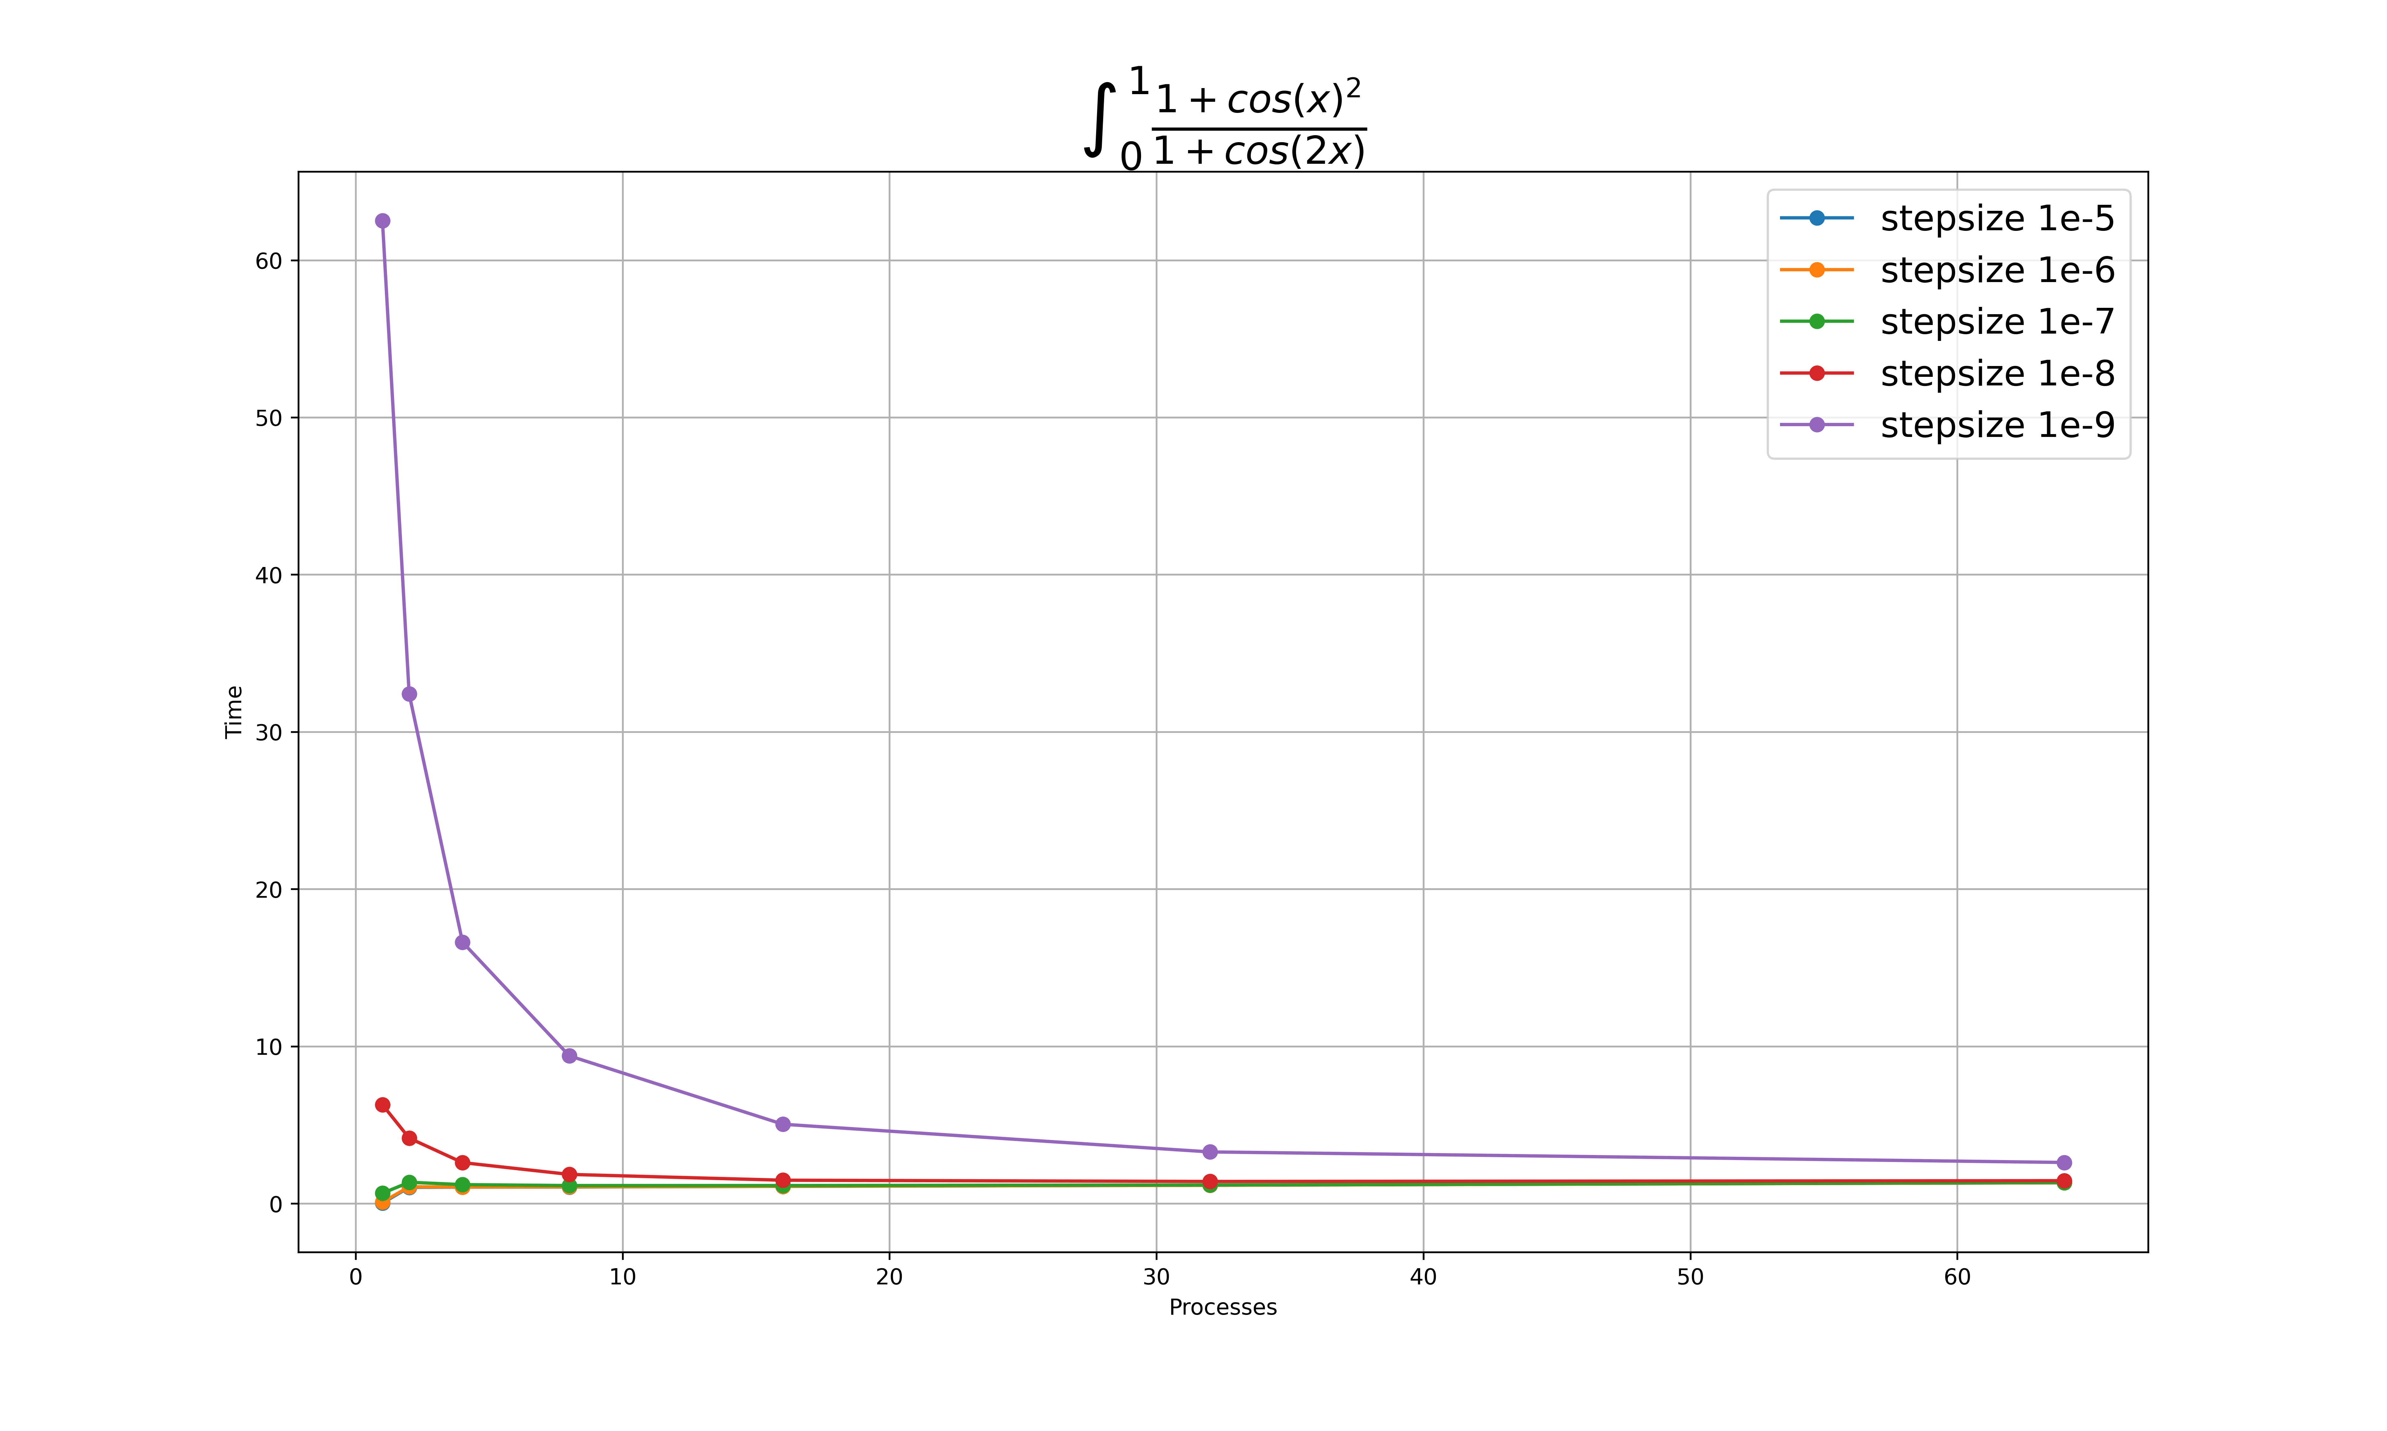
Execution time

Slide 8
Inference
The performance time plot shows the relation between the time taken to solve the problem and the number of the used processes.
The value with one process is equivalent to serial computing.
From the plot, we can infer that for step size greater 1e-8, the serial computing is the most efficient approach, because approximated integral calculation takes less time than required for processes initialization and communication.
The parallel execution becomes more effective than serial only starting from the step size 1e-8 and smaller.

Slide 9
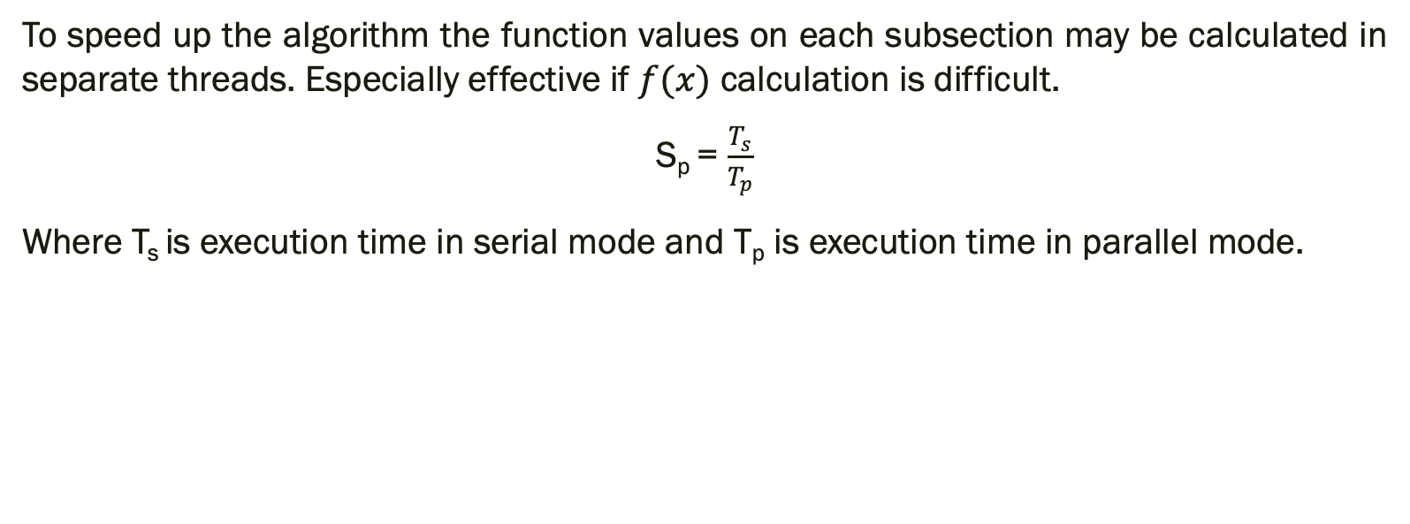
Speed Up
To speed up the algorithm the function values on each subsection may be calculated in separate threads. Especially effective if $f(x)$ calculation is difficult.
S_{p} = $\frac{T_{s}}{T_{p}}$
Where T_{s} is execution time in serial mode and T_{p} is execution time in parallel mode.

Slide 10
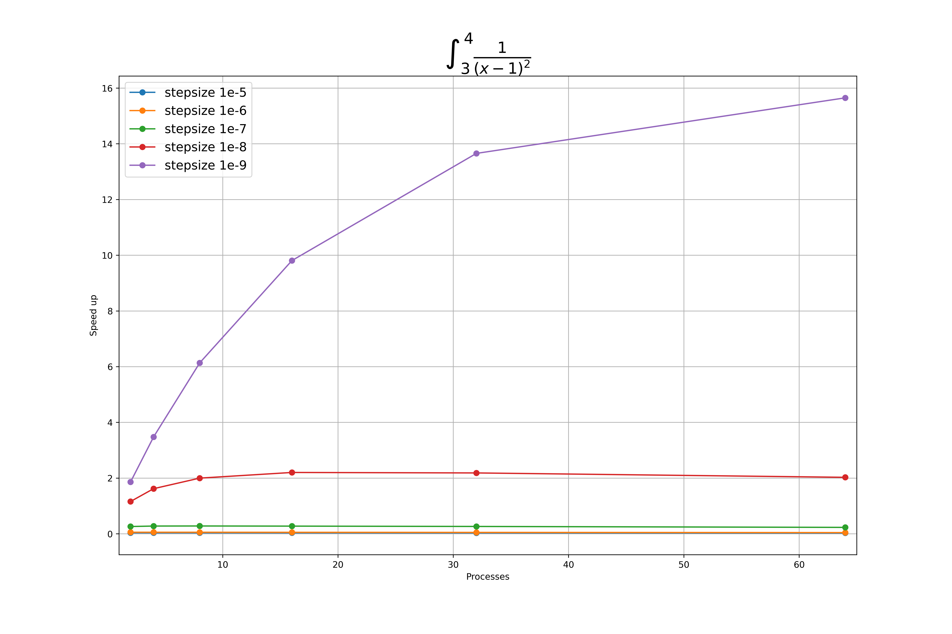
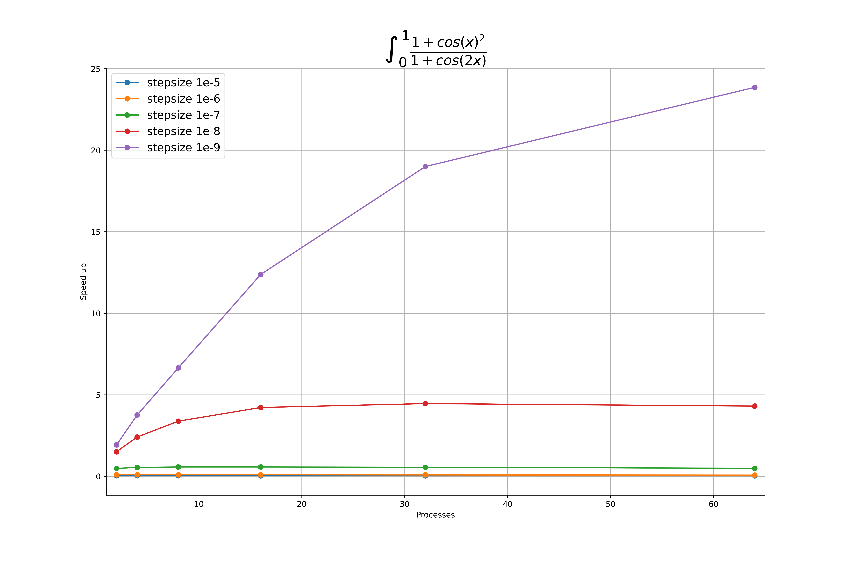
Speed Up

Slide 11
Inference
For the step size greater than 1e-8, the speed up is less than one because the serial computing takes minimum time to solve.
For the step size smaller than 1e-8, the speed-up increases as the number of processors increase and gradually decays.

Slide 12

Efficiency
The parallel efficiency of a program is the ratio of the speedup factor and the number of processors.
E_{p}= $\frac{S_{p}}{p}$
Where S_{p} is the speed-up and p is the number of processors (of cores).

Slide 13
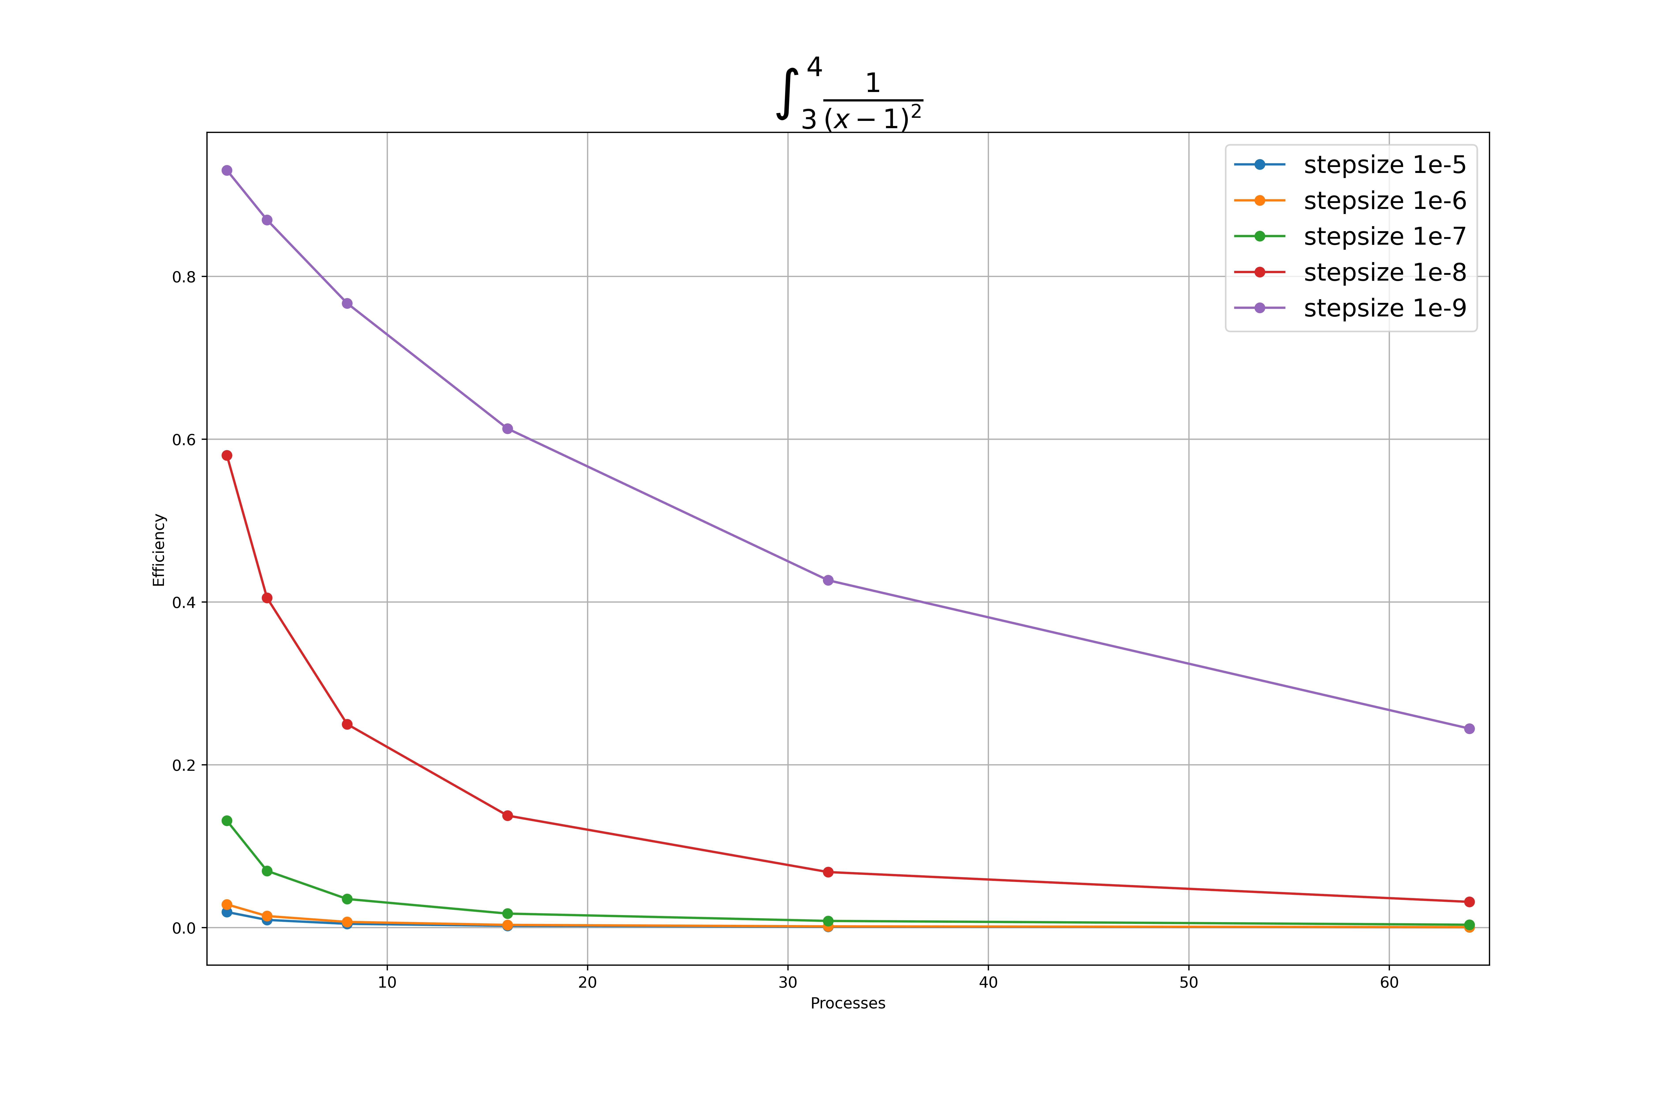
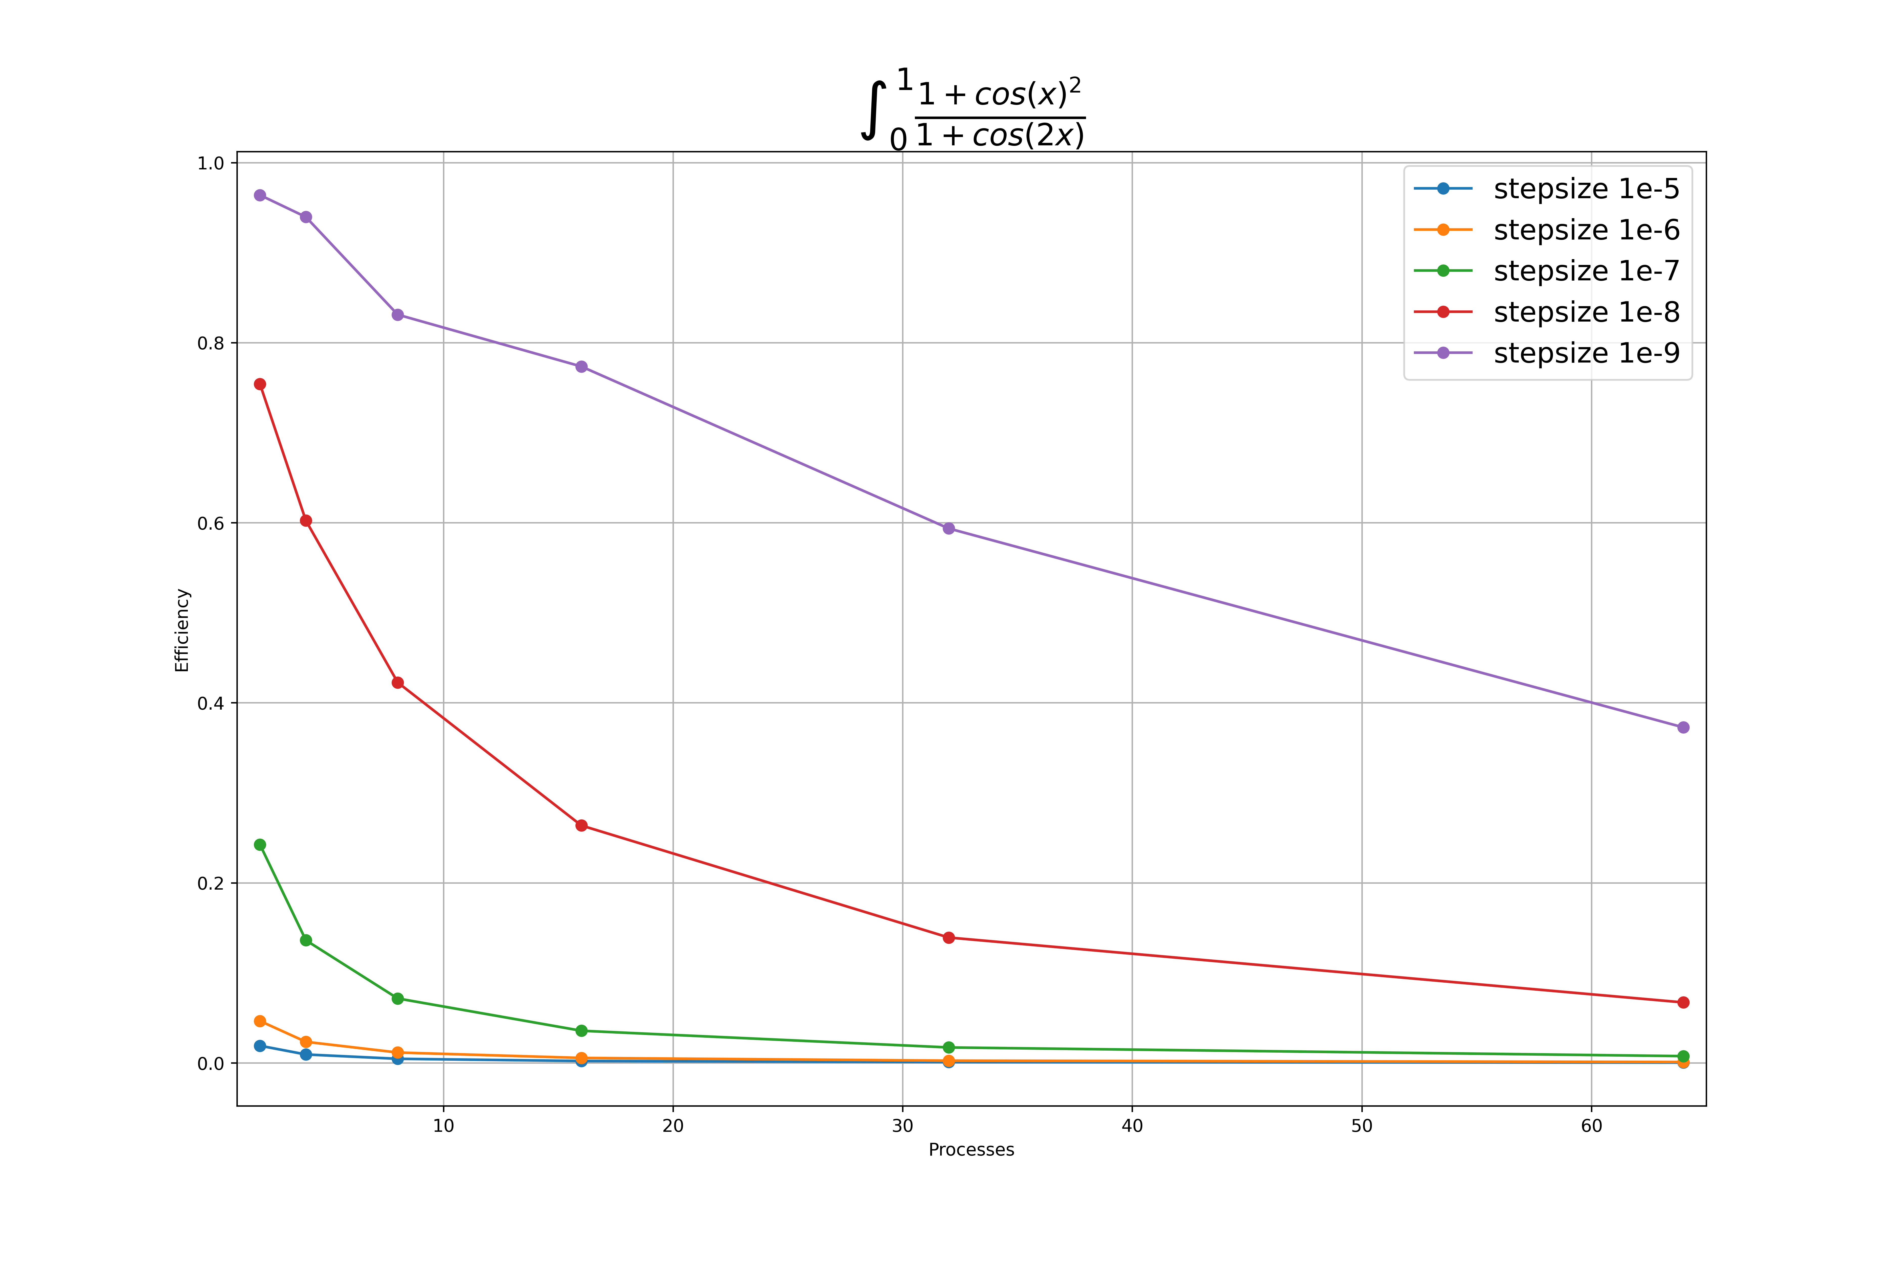
Efficiency

Slide 14
Inference
For step size greater than 1e-8, the maximum efficiency is achieved for the serial computing.
For parallel processing the maximum efficiency is achieved for the smallest step size 1e-9 and two processes.
Although the execution time is decreasing as the number of parallel processes increasing, the efficiency of computation in parallel is decaying.

Slide 15
Summary
The midpoint method of numerical integration in serial and parallel modes was studied and implemented.
For chosen examples the parallel mode of midpoint integration algorithm becomes more efficient than serial starting from the step size 1e-8 and smaller.
The serial computing can perform better when the communication between processes takes longer than the actual algorithm computations.
The speed up of the algorithm does not increase infinitely in parallel with the number of processors and eventually goes down.
It should be avoided to waste excessive computing time on communication between processes.
Computationally complicated functions with smaller step size are better suitable for parallelization.

